Slide 1
What are my Users doing?
Feature adoption tracking in Salesforce
Johann Furmann
jfuermann@gmail.com
@fliack
Notes:
Welcome to todays talk about feature adoption tracking in Salesforce. We want to answer the question: What are my users doing?

Slide 2

About me
Name: Johann Furmann
Location: Berlin
Job: Salesforce Nerd
Trainings: 14x certified, 280+ Trailhead badges
Calling: Dev by curiosity, Admin by heart
Catchphrase: Can this be removed?
Notes:
A little bit about myself. I´m Johann from Berlin, Salesforce Nerd in different roles.
I´m a Dev by curiosity but an Admin by heart.
And my favorit Question is: Can this be removed?
But enough about my self. Let´s get right into it.
-> 1 Min

Slide 3
Agenda
What to track?
How to implement?
Live Demo
Conclusion
Notes:
After this session you all should be able to understand why to track, what to track and how track.
On top of that I will try my hands on a live demo.

Slide 4
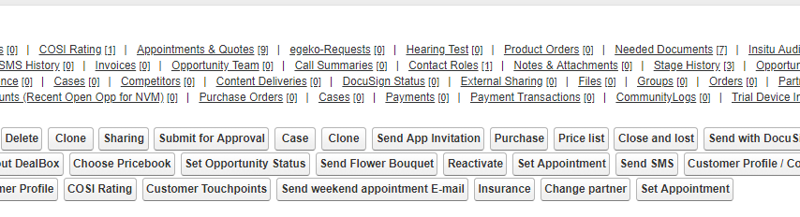
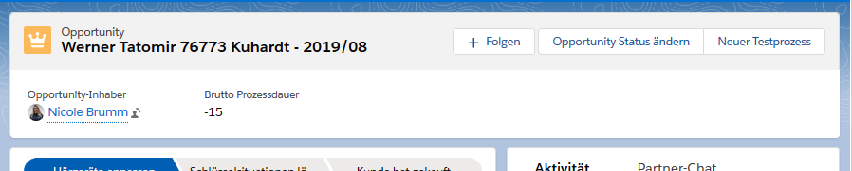
Introduction – Story Time
I can´t sell without that!
This is very important to me!
Just yesterday I needed that.
I use that all the time!
Notes:
That´s what about 10 people build in 4 years. We´ve built 3 rows of buttons and 4 rows of related lists. We worked day and night to deliver all these features. Shouldn´t we be proud of ourself?
The more we build, the louder the users complained:
I don´t like Salesforce. Outlook is much easier too use. Why did you make Salesforce so complicated?
Didn´t be build everything we have been asked to build? Didn´t we always listen to our users?
Most of you have a seen and heard something similar. Users are not happy with your system, some people stop using your Salesforce alltogether.
But how do get the system clean and easy again?
We tried asking the users: What can we remove to make it easier to use?
This wasn´t of any help at all.
„I use that all the the time.“, „Just yesterday I needed that.“ and many more reasons why something couldn´t be removed. We have been stuck.
Who of you has a complicated Org?
Who of you tried and failed cleaning the system?
Our story has a happy end.
And I want to help all of your stories also be a happy end.
In the second picture you see a glimpse of our clean and easy syste.
Same org, same object, same user group and 12 Months later.
We achived the almost impossible. One of the tools we used was feature adoption tracking.

Slide 5
Golden rules
Only a used feature is a good feature.
Only a clean Org is a good Org.
Notes:
For us there are two golden rules:
Only a used feature is a good feature.
Only a clean org is a good.
We live by these rules day by day. Every ticket, every button, every field, every page and every flow is jugged by these two rules.
Not only once but again and again.
Feature adoption tracking allows us to easily follow the two rules.
I want to encourage all of you to also follow these two rules.
Yes, I know it´s hard work and takes dedication to keep a system clean. But your users will thank you for it.
Back to our story, we could reduce the onboarding time from days to hours.
-> 3 Min

Slide 6
What to track?
Fields filled/Records created
Custom Buttons
Page and Lightning tab views
Flows
Specific user inputs
Notes:
But where should I start? What should I track?
Fields filled/Records created
How often is the lead Industry field filled?
-> Check this every three months for every field on the page layout. Yes, it´s tedious work, but the results are amazing.
The next one is harder but not less important. How often is a specific Button in my Record Page clicked?
As you saw in our before pictures, it´s easy to end up with a lot of buttons on your pages.
Just one more button, It´s always just one more button.
The next on is my favorite. Especially since we have lightning it´s easy to create integrate pages. But how many of my pages and tabs are actually viewed on a regular basis?
Furthermore you can track the usage of flows. Flows started and more important, flows finished. Only a finished flow creates business value.
And lastly, we recently implemented that, track specific user input. I will go into details later.
These are some of the things I like to track. I´m looking forward hearing your ideas.
-> 5 Min

Slide 7
How to implement? - Introduction -
SF has no feature adoption tracking out of the Box ☹ ☹ ☹
A few lines of code and one custom object let you implement tracking (almost) everywhere
Implementation after initial setup is really, really fast!
Notes:
Unfortunately Salesforce has no feature adoption tracking built in. This is really sad and a major oversight from Salesforces side.
One custom Object and a few lines of code and we can fix that mistake for Salesforce. Once set up it´s very easy to use.
It´s actually so easy, that in the next ten minutes we will implement tracking for 3 different use cases.
-> 6 Min

Slide 8
How to implement? - Architecture -
Flow
Processbuilder
AdoptionCounter.cls
Adoption_Counter__C
increaseAdoptionCountInvoc
(@InvocableMethod)
increaseAdoptionCount
→ (@AuraEnabled)
performAdoptionOperation
→ DML operation
Action__c (Text)
Feature__c (Text)
Count__c (Decimal)
User (Lookup)
Lighting Component
Visualforce Page
Apex
Notes:
Before we go into the demos a short overview off the architecture.
I will start from the right. The outcome of the tracking is stored in a custom Object, Adoption_Counter__c which has 4 custom fields. Action, Feature, Count, User.
The records are created by a helper class „AdoptionCounter“. This class takes the inputs from different places and transforms it into records in the custom object. The AdoptionCounter Class has about 60 Lines of Code. Pretty lightweight for it´s power.
All the way to the left we have the places from where the helper class „AdoptionCounter“ is invoced.
Flows, Processbuilder, Lightning Components, Visualforce and APEX.
These 5 elements covered all of our use cases, please share your ideas at the end of the session.
Now I will try to demo 3 use cases. Implement tracking for a Lightning Record Pages, a Processbuilder and a lightning component.
-> 8 Min

Slide 9
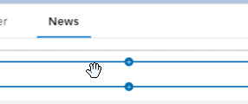
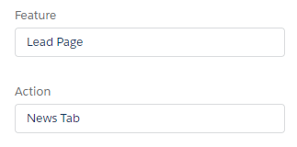
Live Demo I: Lightning Record Page usage
User Story:
As a Product Owner I want to know how often the Tab „News“ on the Lead Detail Page is used.
Tech:
Add helper Lightning Component to the Lightning Record Page Tab „News“
Define two Design Attributes
Create a Report
Notes:
I´ll start with my favorit thing to track. Usage of Tabs on Lightning Pages.
Did you ever wonder who actually clicks on all the tabs you have on your pages. I do, and man am I surprised sometimes.
End: -> 11 Min

Slide 10
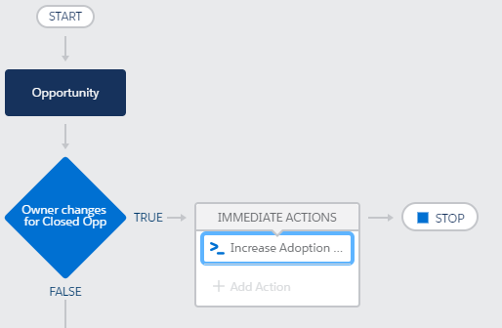
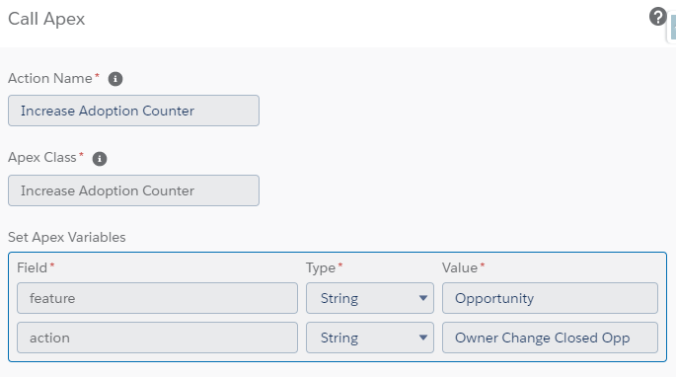
Live Demo II: Database Level Action
User Story:
As an Operations Manager I want to know who changes Opportunity Owner for closed Opportunities in order to stop cheating.
Tech:
Create a Processbuilder which fires every time the Owner of a closed Opportunity is changed.
For action call APEX method ‚Increase Adoption Counter‘
Define the Input Parameters
Create a Report
Notes:
The next example is about cheating.
Yes, sometimes in Sales people cheat. One way of cheating is to change the Opportunity owner of a closed Opportunity.
This is a seriouse thing.
Luckily for us, it can easily be tracked.
This siutation creates the following business requirement:
As an Operations Manager I want to know who changes Opportunity Owner for closed Opportunities in order to stop cheating.
End: -> 14 Min

Slide 11
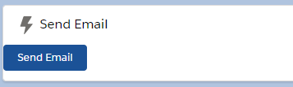
Live Demo III: Custom Lightning Component
User Story:
As a Product Manager I want to know how often the Button „Send Email“ is clicked.
Tech:
Add the AdoptionCounter action invocation to the button click.
Pass Attributes Feature
Create Report
<c:FeatureAdoptionTracker feature = "Send Email" action="Button Click" fireOnInit = "false" aura:id="fAdoptionTracker"/>
component.find("fAdoptionTracker").increaseCount();
Notes:
End: -> 17 Min

Slide 12
What to do with gathered data?
Before Go-Live of any feature define expected usage
Track adoption regurarly
Inform Stakeholders about adoption
Decide about next steps for each feature based on adoption training/communication, further development or removal
Notes:
Before Go-Live of any feature define expected usage (e.g. 100 Page views per day, 50 clicks per weeek...)
Decide about next steps for each feature based on adoption: training/communication to improve adoption, further development for very popular features or removal of a feature if adoption is low.
End: -> 19 Min

Slide 13
Conclusion
Implementating tracking is very easy
Adoption tracking is part of feature livecycle
Adoption tracking keeps an org clean
Notes:
End: -> 20 Min

Slide 14
Q & A
Feature adoption tracking in Salesforce
What are my Users doing?
Johann Furmann
jfuermann@gmail.com
@fliack

Slide 15
Backup Info
Username: jfuermann+featureAdoptionTracking@gmail.com
Password: Password12345
Preperation:
- Clean Data
delete [SELECT Id FROM Adoption_Counter__c];
Lead Record
Lead Record Page Editor
Processbuilder (Opportunity Update Handler)
Dev Console (Send Email Component)

